Slide 1
Project on Bank Analytics
Group -4
Mounikabenarjee kantamaneni
Sakshi Santosh Chavan
Hrushabh Arvind Shinolkar
Shubham Kishor Pethe
Mrunmai Vinayak Devlekar
Vishal Kumar
Rohan Khilari

Slide 2
Cleaning the data and merging the data
Steps –
Analysed the data
Transferred the data in power query and made changes and merged the data.
Then we started to use Pivot table to make visuals.

Slide 3
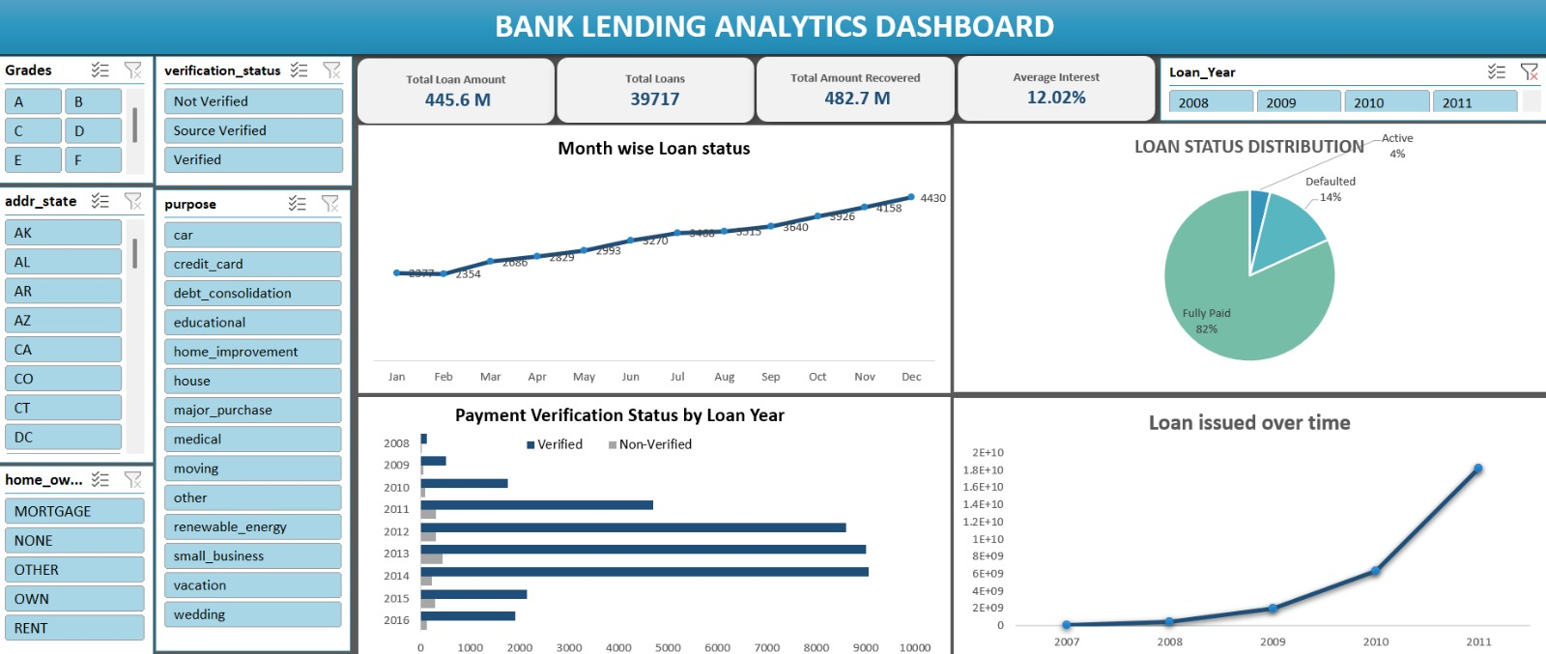
Excel

Slide 4
Total Loans: 39,717 | ₹445.6M disbursed
Recovered: ₹482.7M → good recovery overall
Avg Interest: 12.02%
Loan Status:
Fully Paid: 82%
Defaulted: 14%
Active: 4%
Monthly Trend: Loans rise steadily toward year-end → demand peaks late months.
Over Years: Loan issuance shoots up from 2009–2011 → fast expansion phase.
Verification: Verified payments dominate → safer portfolio.
Suggestion for the Bank :
Cut defaults: Focus tighter checks on risky profiles & states.
Push verification: Mandatory verification = lower losses.
Prepare for year-end rush: Add staff + faster processing in peak months.
Target good borrowers: Expand lending to high “fully-paid” grade segments.
Monitor growth risk: Rapid loan growth → strengthen credit policy.
Refine pricing: Use grades to adjust interest rates smartly.

Slide 5
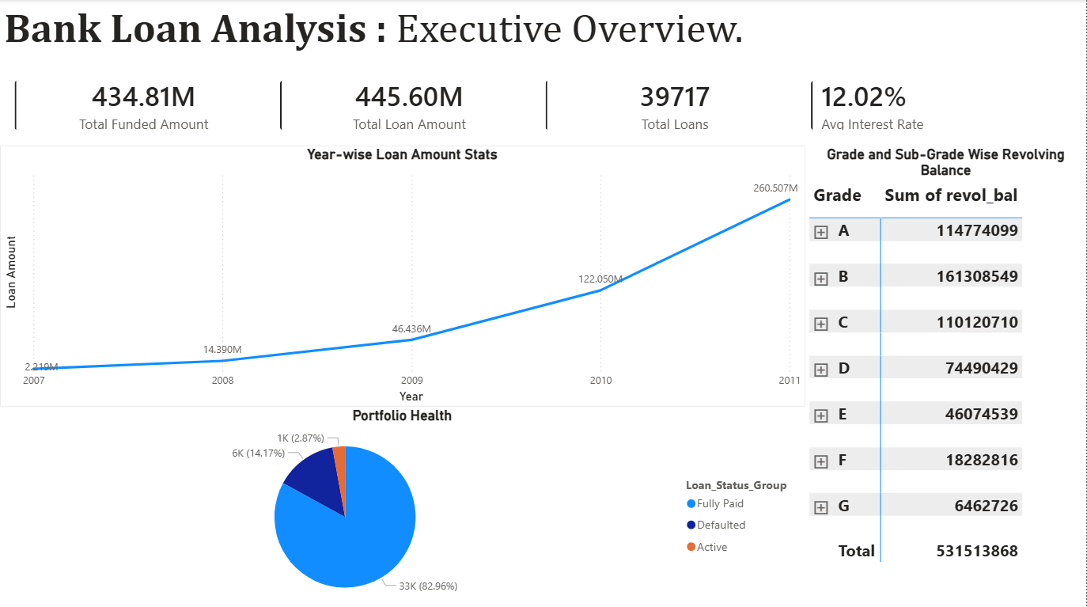
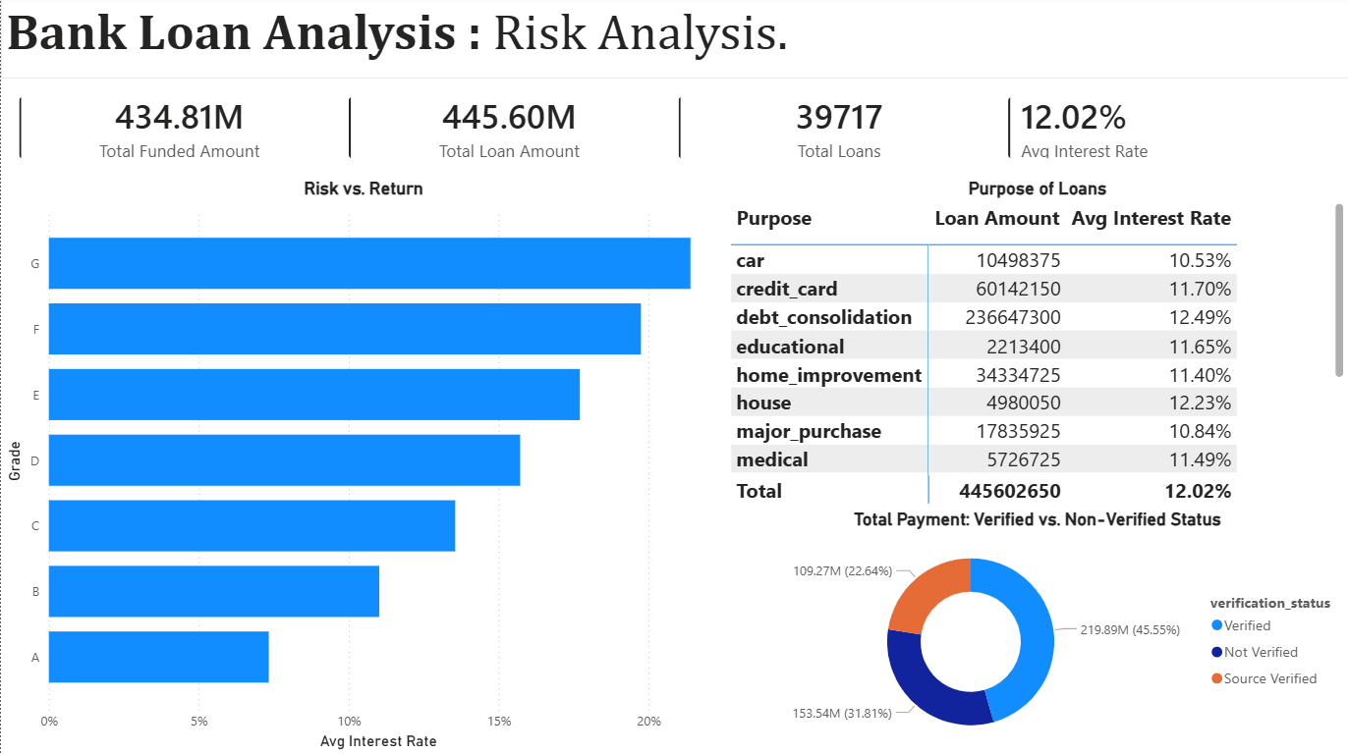
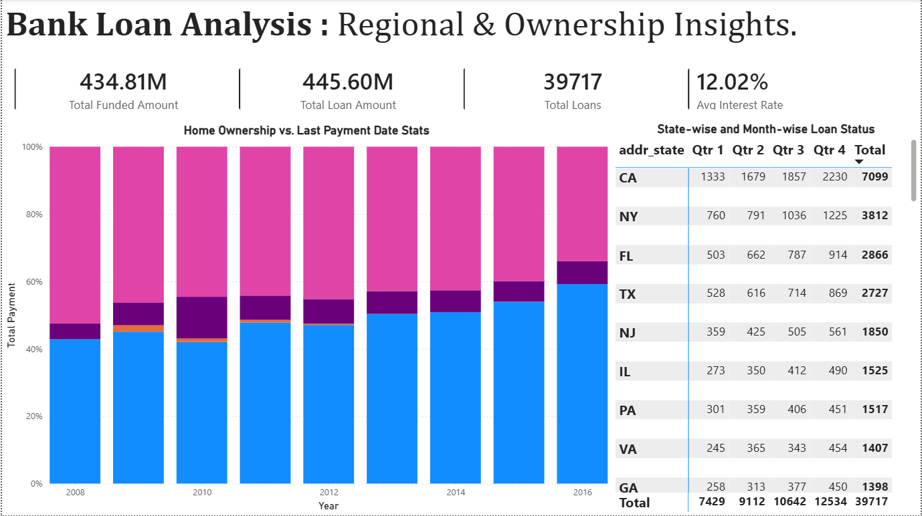
Power Bi

Slide 6
Risk by Grade
Grade G–E = highest risk
Grade A–B = safest
Biggest volumes: Debt consolidation & home improvement
Highest rates mostly tied to riskier purposes
Region & Ownership
Some states dominate loan counts (CA, NY, FL).
Home-ownership + payment status strongly linked to defaults.
Suggestions for the Bank
Tighten rules for E–G grades → reduce defaults.
Scale A–B grade lending → safer profit growth.
Make verification mandatory for risky segments.
State-wise risk pricing (higher-risk regions → higher rates / stricter checks).
Factor home-ownership into scoring models.
Control rapid growth with better stress testing.
Reprice by purpose (debt consolidation & risky uses).

Slide 7
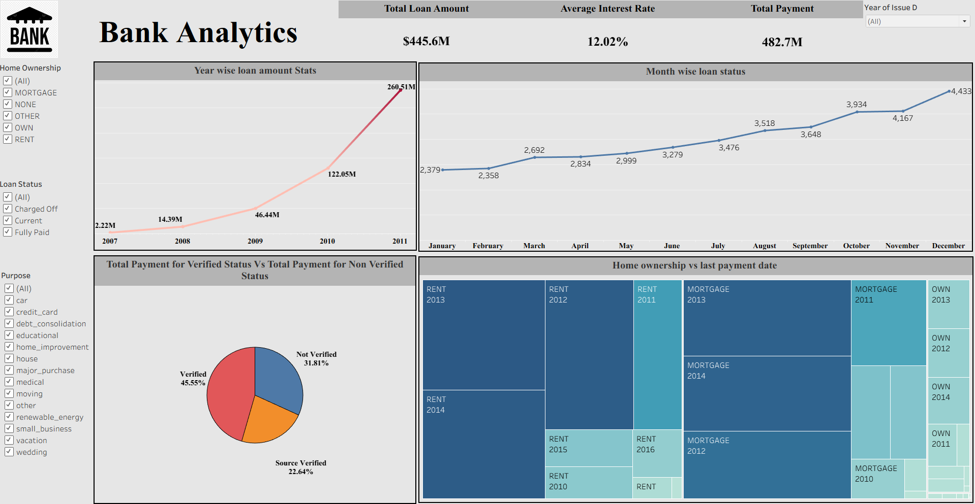
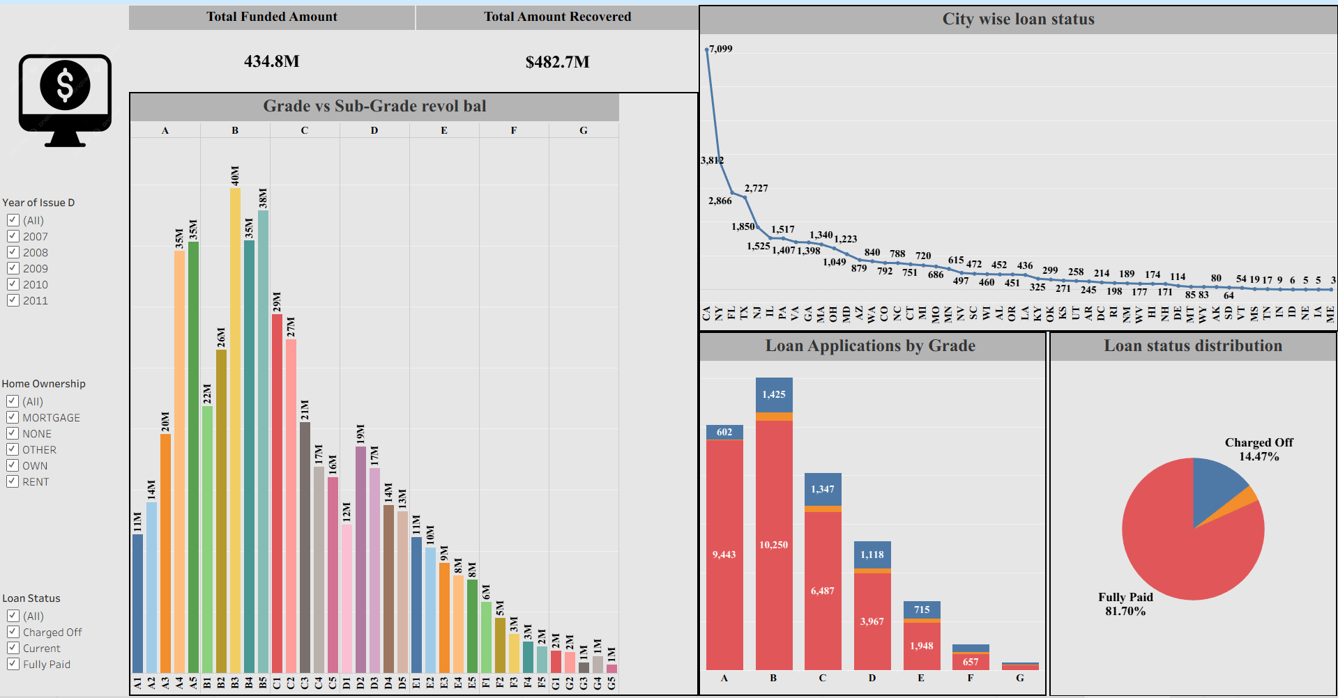
Tableau

Slide 8
Rapid Growth - Portfolio scaled from $2.2M (2007) to $260M (2011).
Revenue Drivers: Debt Consolidation is your anchor product ($236M), and California is your primary market (7,099 loans).
Risk Profile: Strong recovery rate with 83% Fully Paid, but the 14.2% Default Rate is a high-cost leak that needs plugging.
Profitability: Average interest rate sits at 12.02%, with Grade G loans yielding over 20% to offset risk.
Strategic Recommendations
1. Mitigate Risk
Verification Gap: 32% of payments come from "Not Verified" sources. Mandate verification for high-risk grades (E, F, G) to lower the 14% default rate.
Exposure Cap: Reduce geographic concentration in California to insulate the bank from state-specific economic shocks.
2. Optimize Product Mix
Diversify Purpose: Move beyond Debt Consolidation. The Home Improvement and Car segments show lower interest rates (10–11%), suggesting lower-risk borrowers that could stabilize the portfolio.
3. Operational Timing
Q4 Surge: Data shows a consistent volume spike in the final quarter. Increase liquidity and marketing spend in September/October to capture high-intent year-end borrowers.

Slide 9
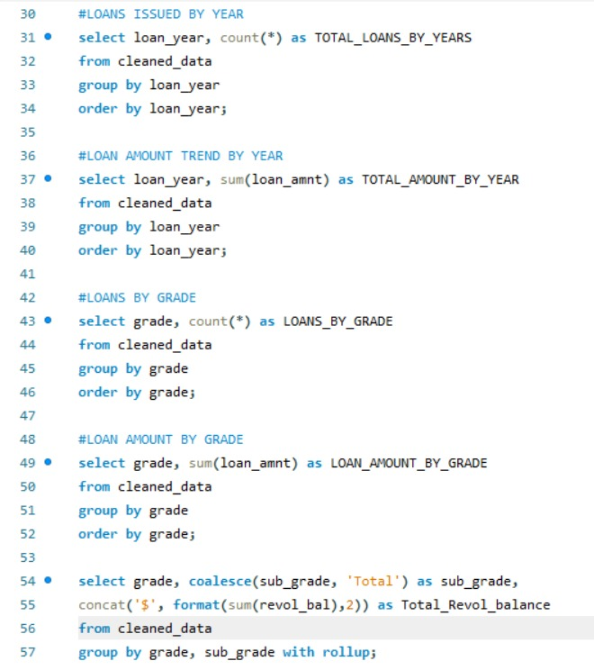
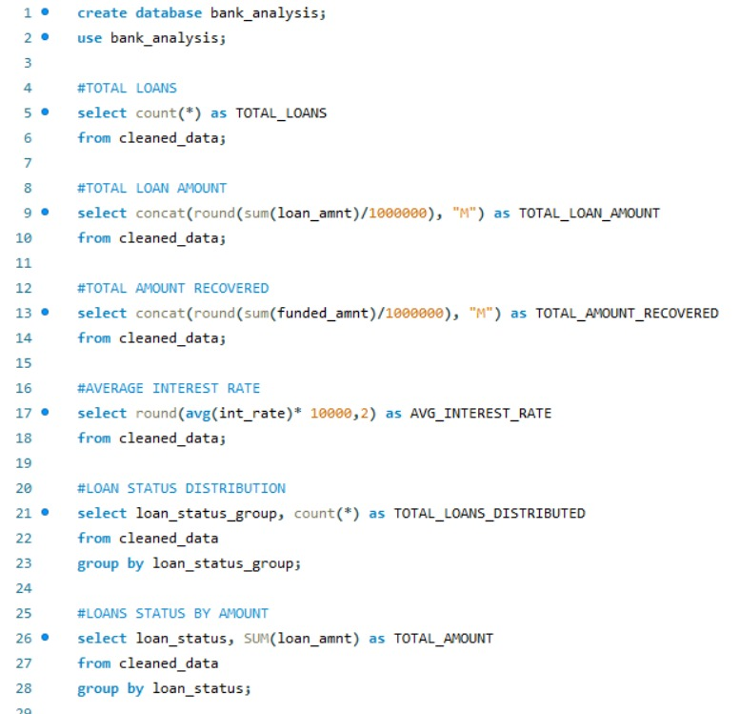
SQL Queries

Slide 10
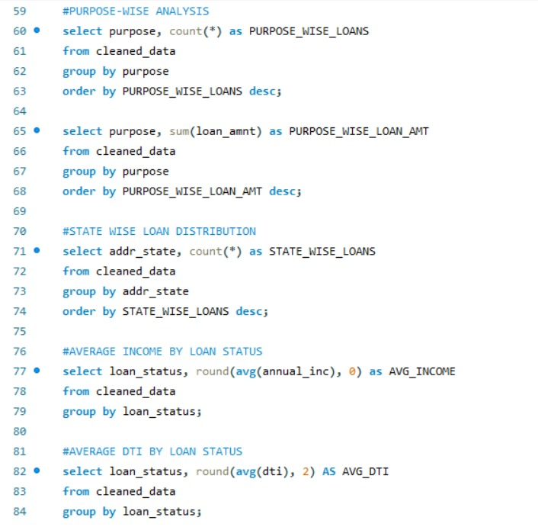
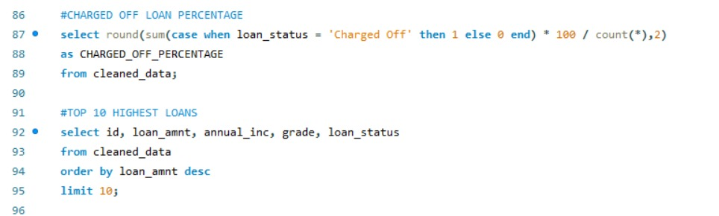

Slide 11
What we learnt.
Strong Growth Phase: Loans and amounts surged from 2009–2011 → rapid expansion needed tighter risk controls.
Healthy Portfolio (with caution): ~83% fully paid, ~14% default → generally strong but room to reduce losses.
Risk by Grade: A–B grades are safest; E–G carry highest default risk → supports risk-based pricing.
Purpose Matters: Debt consolidation & home improvement dominate volumes and show higher risk-linked rates.
Geography & Ownership Impact Risk: Certain states and home-ownership types influence repayment behavior.
Verification Reduces Loss: Verified borrowers perform better → key lever for portfolio quality.
Data → Decisions: SQL + Power BI transformed raw data into actionable insights for growth, pricing, and risk strategy.

